Slide 1


INTERNATIONAL CONFERENCE ON RECENT ADVANCEMENTS IN ARTIFICIAL INTELLIGENCE, COMPUTATIONAL INTELLIGENCE, AND INCLUSIVE TECHNOLOGIES ICRAIC2IT - 2025

Slide 2


Voltage Stability Enhancement in Microgrids: An ANN-Based Droop Control Approach
Jishnu Teja Dandamudi, Rupa Kandula
Amrita School of Artificial Intelligence, Amrita Vishwa Vidyapeetham, Coimbatore, Tamil Nadu, India
djishnuteja2006@gmail.com, rupakandula21@gmail.com

Slide 3
OBJECTIVES
1. Improve Voltage Stability in Microgrids -
Aims to reduce voltage fluctuations in microgrids, especially under varying loads and renewable energy sources.
2. Combine ANN with State-Space Modeling -
The study merges ANN with mathematical modeling (state-space) to better understand and control the microgrid’s behavior.
3. Compare With Traditional Methods -
It compares the ANN-based method to regular and optimized droop control, showing that ANN gives better voltage and frequency stability.

Slide 4
• What is ANN ?
An Artificial Neural Network (ANN) is a computational model inspired by the human brain, designed to learn and make predictions from data. It consists of interconnected nodes called artificial neurons, organized in layers, that process information and adjust their connections based on input data.
• What is Droop Control ?
Droop control in a microgrid is a decentralized control strategy that allows multiple distributed energy resources (DERs) to share load and maintain stable voltage and frequency without the need for central control or communication.
• What is State-Space Modelling ?
State-space modeling is a mathematical approach that describes a system's behavior using a set of first-order differential equations, where the state variables represent the system's internal state.

Slide 5
KEY COMPONENTS OF ANN
1. Neurons (Nodes):
These are the basic units of an ANN. Each neuron receives input, processes it, and passes on the output to the next layer of neurons.
2. Layers:
Input Layer: Receives the initial data or features.
Hidden Layers: Process the inputs by applying mathematical transformations. These layers are called "hidden" because they are not directly observed.
Output Layer: Produces the final result or prediction.
3. Weights:
Each connection between neurons has a weight, which determines the importance of the signal being passed between neurons.
4. Activation Function:
This function helps decide whether a neuron should be activated or not. Common activation functions include the sigmoid, tanh, and ReLU (Rectified Linear Unit).
5. Training:
The network learns by adjusting its weights through a process called training, often using algorithms like backpropagation to minimize the difference between predicted outputs and actual values (errors).

Slide 6

APPLICATIONS
Image and Speech Recognition
Natural Language Processing (NLP)
Predictive Analytics
Autonomous Vehicles
Microgrid
Maintain stable voltage levels in an islanded (autonomous) microgrid by predicting voltage deviations and optimizing control actions in real-time.
Used in systems like facial recognition, voice assistants, etc.
For tasks like translation, chatbots, and text analysis.
Forecasting stock prices, weather patterns, and more.
Helping self-driving cars make decisions based on sensory data.

Slide 7
FLOW OF METHODOLOGY
Model microgrid system
Apply droop control
Train ANN model
Predict voltage/frequency
Compare with traditional
A mathematical model of the microgrid is built using state-space equations.
Adaptive droop equations are used to control voltage and frequency based on power.
A neural network is trained on simulated power data to learn voltage and frequency behavior.
The trained ANN predicts voltage and frequency more accurately in real time.
The ANN-based method is tested against standard droop control to show improved stability.

Slide 8
MODEL MICROGRID SYSTEM – STEP-BY-STEP
• Identify key parts -
Include voltage, current, frequency, control signal, and PI controller in the model.
• Use basic electrical rules -
Apply Kirchhoff’s Laws to describe how voltage and current change over time.
• Include virtual inertia -
Add equations to show how frequency changes when power changes (to mimic real generators).
• Write equations in matrix form -
Convert all the system behavior into state-space equations (A, B, C, D matrices).
• Prepare for simulation -
Finalize the model so it can be used in Python to simulate microgrid behavior under different power loads.

Slide 9
METHODOLOGY
• This project employs an Artificial Neural Network (ANN)-based approach to enhance voltage and frequency stability in microgrids by replacing traditional droop control with a data-driven predictive model.
• Synthetic active and reactive power inputs (P, Q) are generated to mimic varying load conditions, while real voltage and frequency measurements from PMU data are used as targets. The ANN is trained to learn the nonlinear relationship between P, Q and the corresponding voltage and frequency outputs, with a strong focus on optimizing voltage near 230V.
• The dataset is normalized using Min-Max scaling, and a deep neural network with multiple dense layers is trained using a custom loss function that heavily penalizes deviations from the desired voltage level. This ensures the model not only minimizes prediction error but also actively regulates voltage toward the optimal 230V. After training, the ANN is evaluated against test data, and its predictions are compared to actual values to assess performance.
• Plots of voltage, frequency, and loss evolution visually demonstrate the ANN’s effectiveness. This methodology aligns with the paper’s proposed adaptive ANN-based droop control framework, providing a scalable, real-time solution for voltage and frequency regulation in dynamically changing microgrid environments.

Slide 10
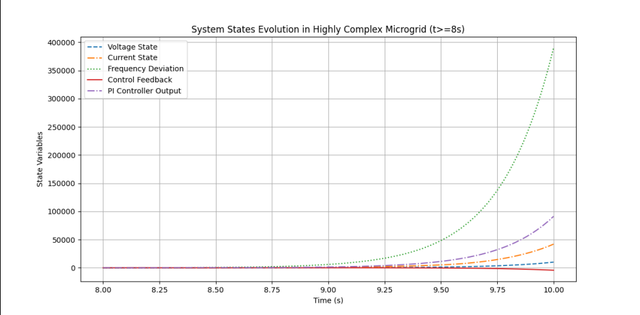
RESULTS
The graph illustrates the evolution of system states in a highly complex microgrid from 8 seconds onwards, focusing on key variables such as voltage state, current state, frequency deviation, control feedback, and PI controller output. The time axis ranges from 8.25 to 10.00 seconds, showing how these states fluctuate or stabilize over time. This visualization helps in analyzing the microgrid's dynamic behaviour, particularly in terms of frequency stability and control system performance under complex conditions.

Slide 11
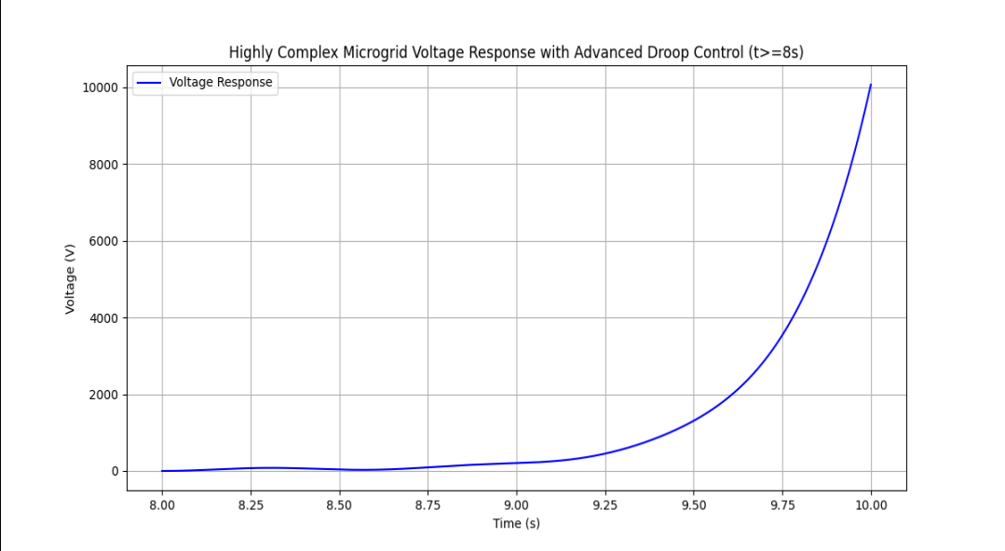
The graph depicts the voltage response of a highly complex microgrid from 8 to 10 seconds, highlighting the performance of an advanced droop control system. The voltage (V) is plotted against time (s), showing how the system stabilizes or fluctuates in response to disturbances or load changes. This visualization is crucial for evaluating the effectiveness of the droop control in maintaining voltage stability under dynamic conditions in the microgrid.

Slide 12
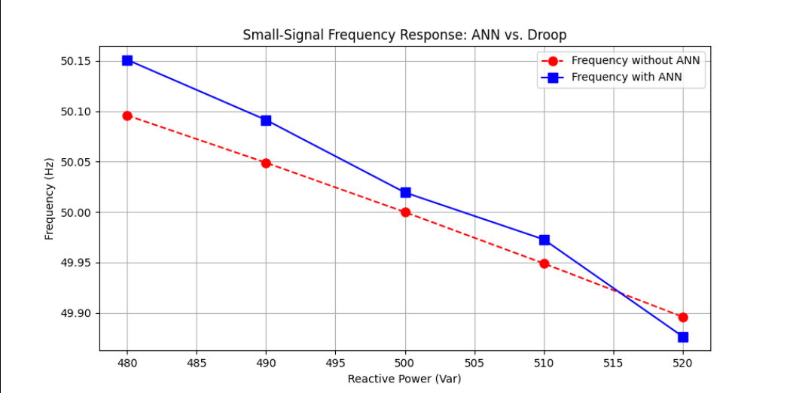
The graph compares the small-signal frequency response of a microgrid using two different control methods: traditional droop control and an ANN (ANN)-based approach. The frequency (Hz) is plotted against reactive power (Var), showing that the ANN-controlled system (blue line) maintains tighter frequency stability around 50 Hz compared to the droopcontrolled system (red line), especially under varying reactive power conditions. This demonstrates the superior performance of ANN in minimizing frequency deviations and enhancing grid reliability.

Slide 13
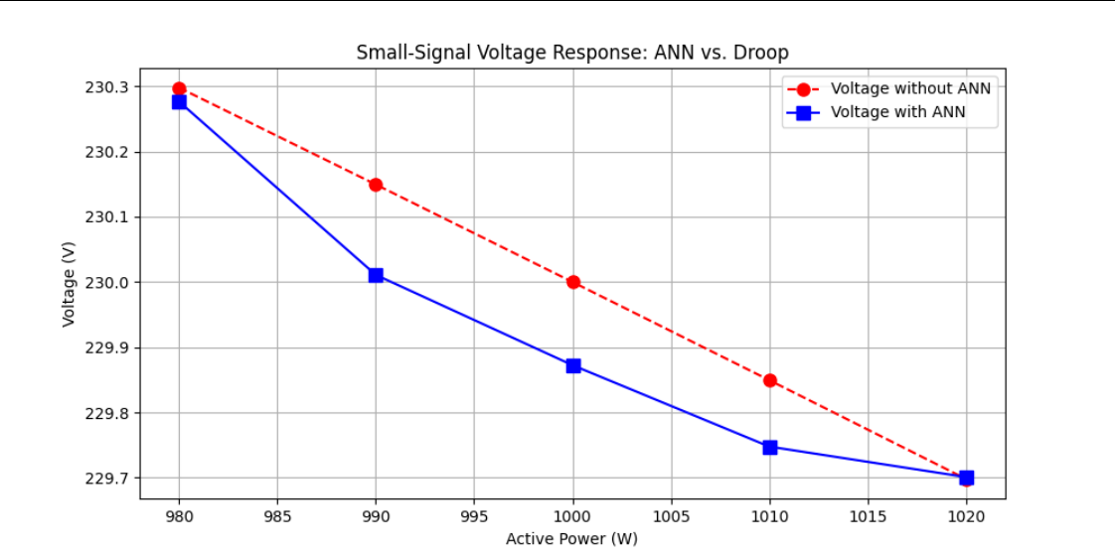
The graph compares the small-signal voltage response of a microgrid under two control strategies: conventional droop control and an ANN-based approach. The voltage (V) is plotted against active power (W) as shown in Figure, revealing that the ANN-controlled system (blue line) maintains more stable voltage levels near 230 V with smaller deviations compared to the droop-controlled system (red line). This highlights the ANN's superior ability to regulate voltage under varying active power conditions, ensuring better grid stability and performance.

Slide 14
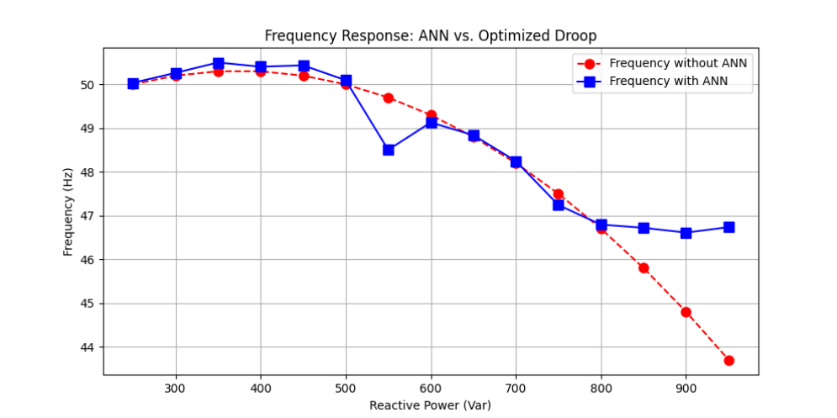
The graph compares the frequency response of a microgrid using an ANN control versus a traditional optimized droop control method. The frequency (Hz) is plotted against reactive power (Var), demonstrating that the ANN-based control (blue line) achieves more stable frequency regulation across a wide range of reactive power variations (300–900 Var) compared to the droop-controlled system (red line). The ANN maintains frequency closer to the nominal value (likely 50 Hz or 60 Hz, though not explicitly labelled), with smaller deviations, particularly under higher reactive power loads. This suggests that ANN control enhances grid resilience and dynamic performance, reducing frequency fluctuations that could otherwise affect power quality. The optimized droop method, while improved over basic droop, still shows greater sensitivity to reactive power changes.

Slide 15
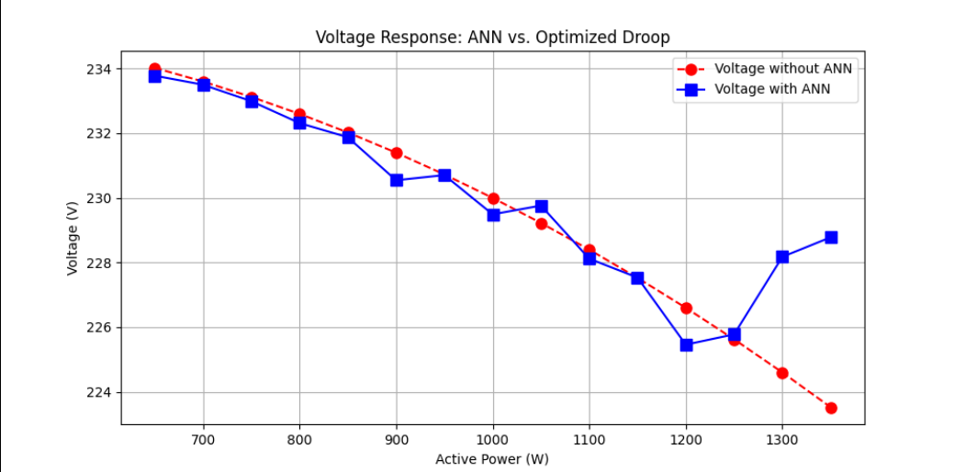
The graph compares the voltage response of a microgrid using ANN control versus optimized droop control, plotting voltage (V) against active power (W). The ANN-controlled system (blue line) demonstrates superior voltage stability with minimal deviations across varying loads (700–1300 W), while optimized droop (red line) exhibits larger fluctuations, particularly at higher power levels. This highlights ANN's effectiveness in maintaining consistent voltage regulation, making it a more reliable solution for dynamic microgrid operations compared to traditional droop-based methods as depicted in Figure

Slide 16

CONCLUSION
This study highlights the effectiveness of an ANN-based droop control framework in enhancing the stability and dynamic performance of complex microgrid structures. A comparative evaluation against conventional and optimized droop techniques confirms that the ANN-based method significantly improves voltage and frequency regulation during oscillating load patterns. Empirical results depict that the incorporation of ANN mitigates frequency fluctuations, imposes tighter voltage stability, and enhances overall system robustness. These improvements together enhance power quality and grid reliability, especially in dynamically changing microgrid environments. The findings confirm ANNbased control as a reliable substitute for traditional droop mechanisms in contemporary power systems. In addition, the ANN model demonstrates better adaptability to nonlinear power fluctuations, suppressing transient oscillations and improving system response time. Future research will potentially explore hybridized learning frameworks and more advanced optimization methods to further enhance ANN effectiveness, with greater stability and operational performance under a wide variety of microgrid conditions.

Slide 17

FUTURE WORKS
Future studies will be directed at further improving the ANN-based droop control with real-time learning algorithms and adaptive tuning methods to enable the system to automatically tune its control parameters in accordance with changing grid conditions. Moreover, incorporating reinforcement learning algorithms could highly improve the ANN's decision-making capacity to adjust voltage and frequency control dynamically with respect to extremely uncertain and transient disturbances. Experimental verification by hardware-in-the-loop (HIL) simulations and actual microgrid testbeds will be imperative to guaranteeing the application feasibility and resilience of the presented method. Further, the development of the ANN control framework for multi-microgrid systems with decentralized control coordination will be investigated for enhancing the scalability, interoperability, and reliability in large-scale power grids. Incorporating federated learning and distributed AI methods can further advance joint decision-making between multiple microgrids while guaranteeing minimal control action latency. Additionally, incorporating hybrid ANN models with physics-informed learning may offer deeper insights into power-electronic interactions, improving predictive precision of voltage and frequency stabilization under nonlinear grid conditions. Mitigating cybersecurity issues related to AI-based control in power systems will be another critical area of focus, with the adoption of secure communication protocols and anomaly detection techniques to protect against potential cyber attacks. Lastly, studying the economic effects of ANN-based droop control on power system economics, such as cost-benefit analysis and energy efficiency enhancements, will yield important insights into its viability for large-scale implementation in contemporary smart grids.

Slide 18
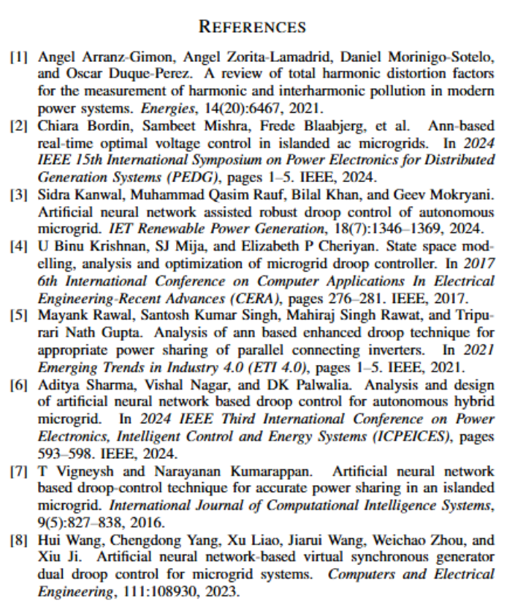

Slide 19

THANK YOU

